Slide 1

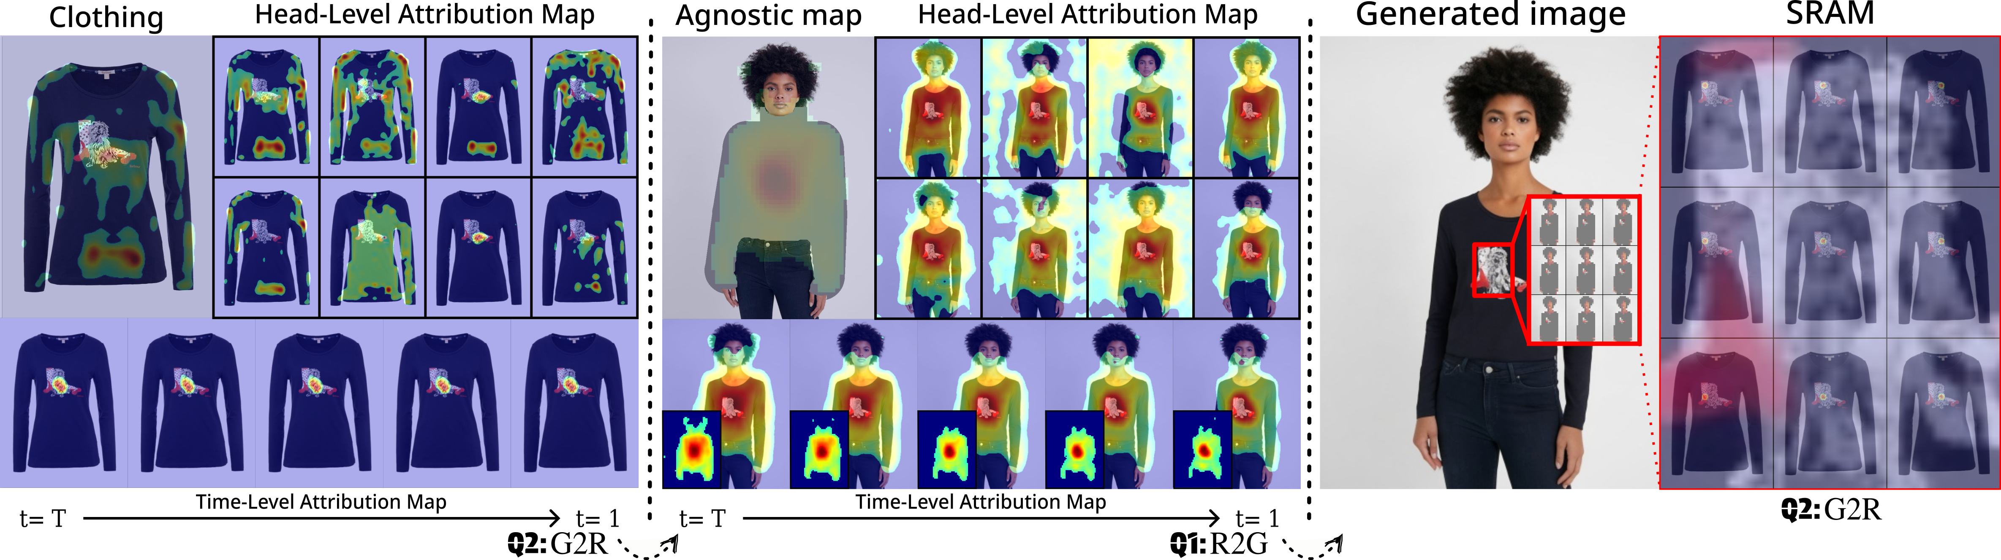
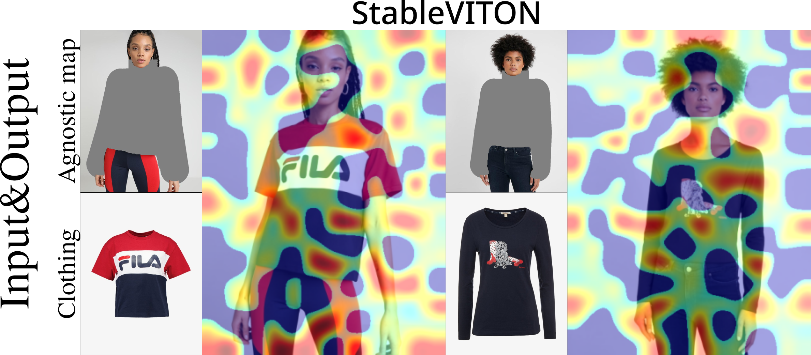
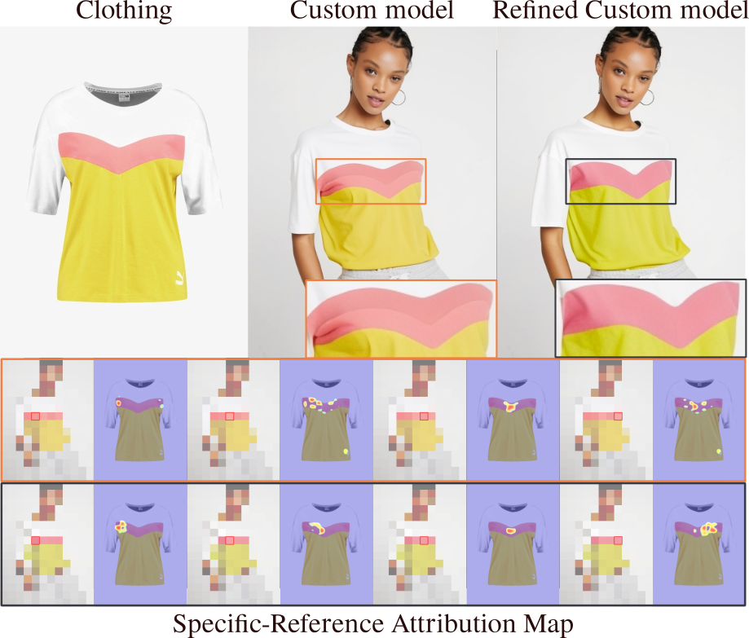
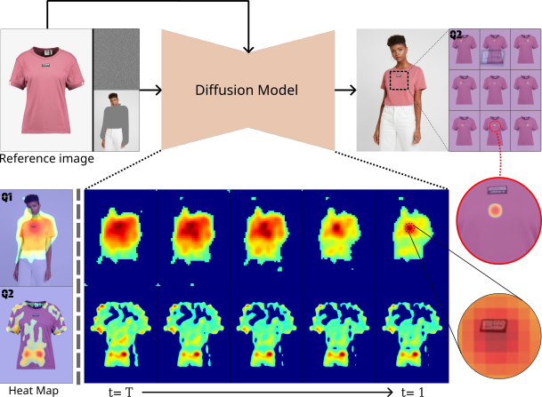


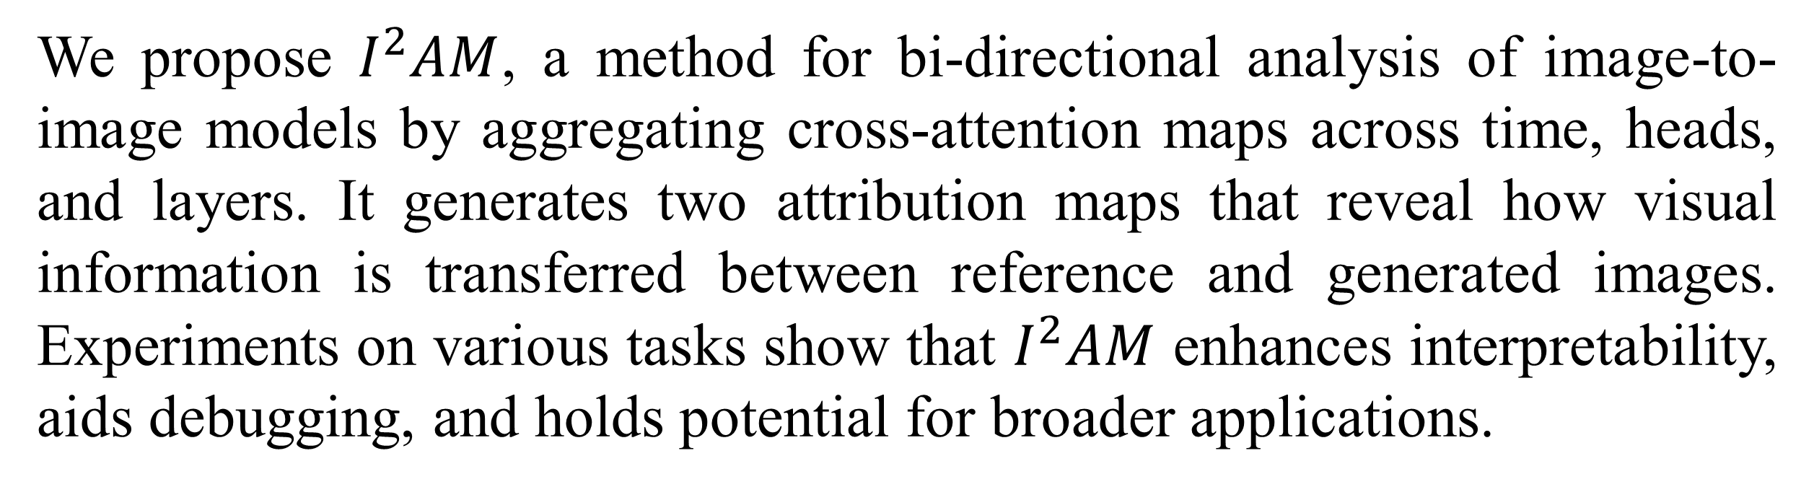

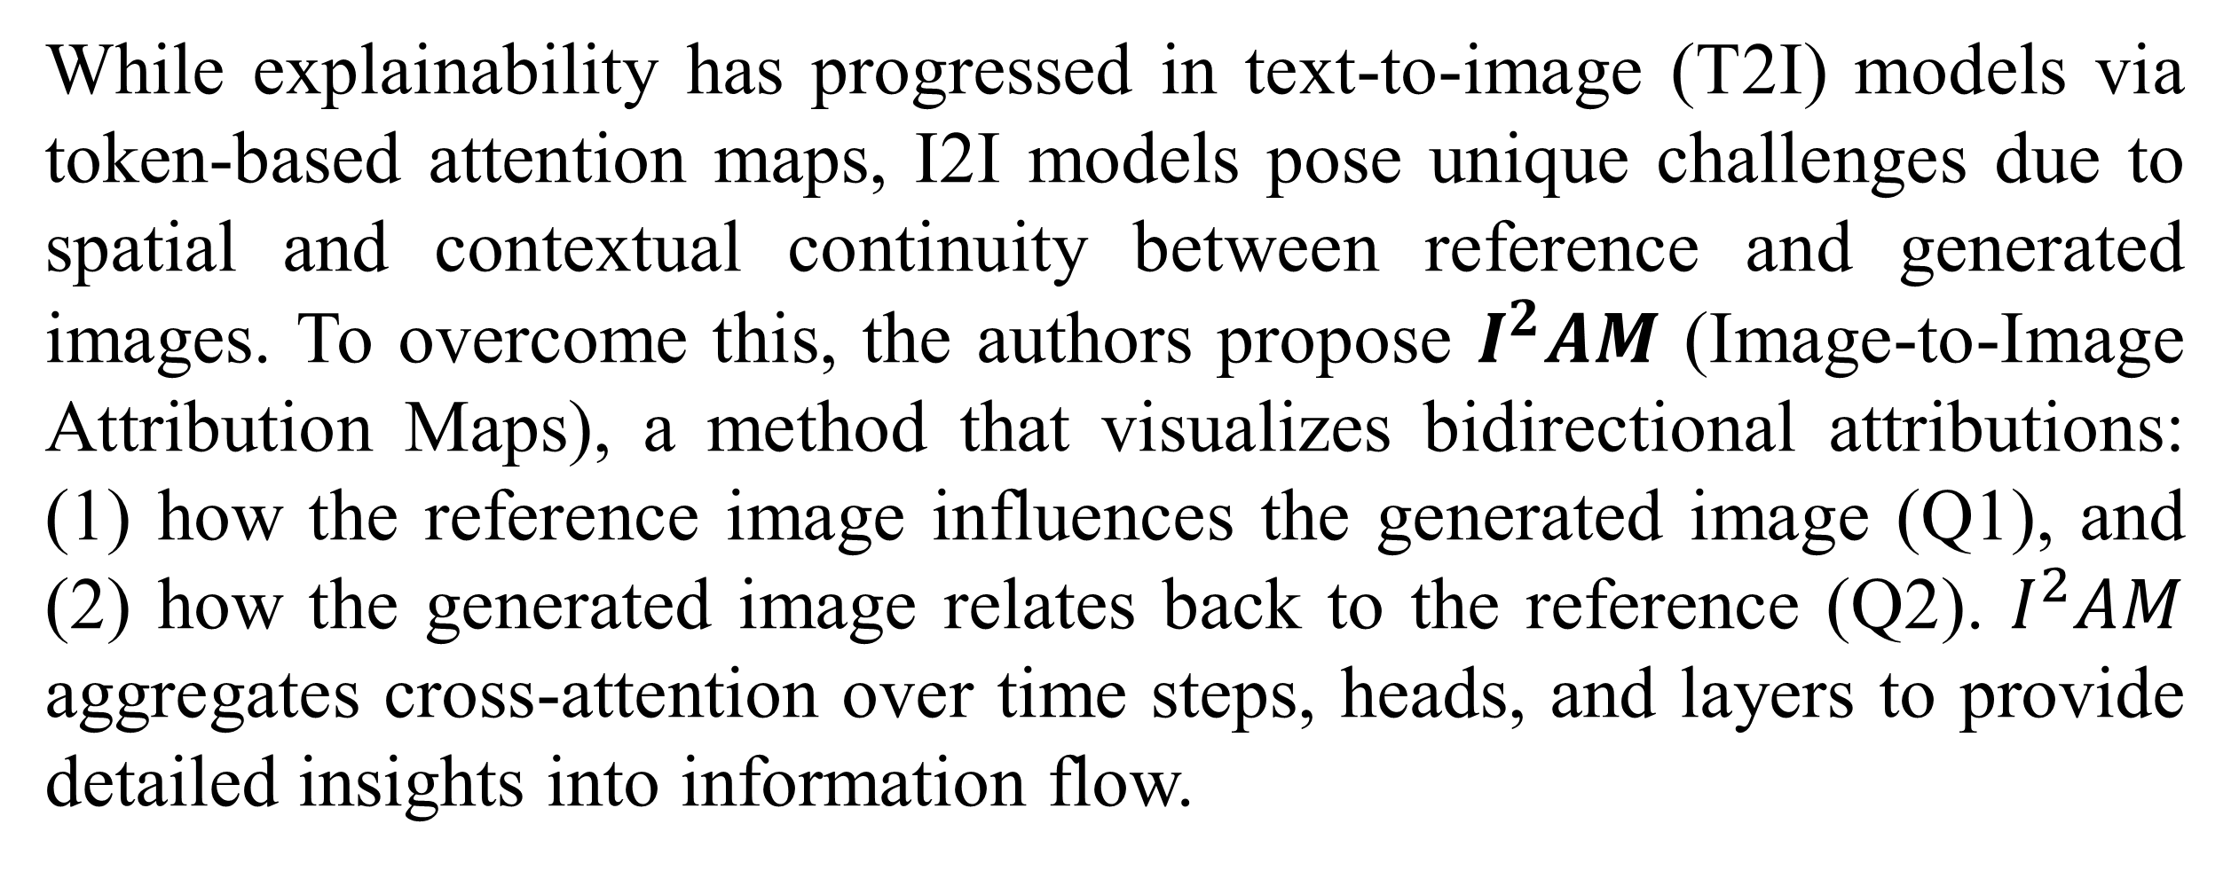
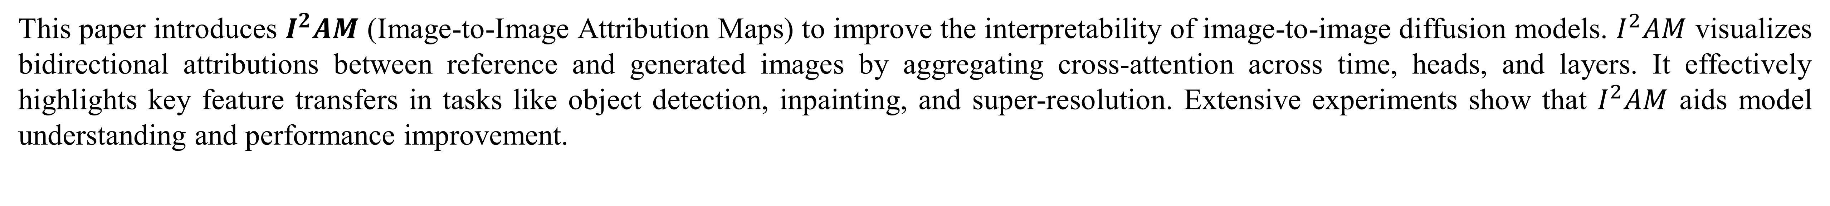
AI융합혁신대학원 I 동국대학교
$I^{2}AM$: Interpreting Image-to-Image
Latent Diffusion Models via Bi-Attribution Maps
Junseo Park and Hyeryung Jang, Dongguk University
Abstract
This paper introduces $I^{2}AM$ (Image-to-Image Attribution Maps) to improve the interpretability of image-to-image diffusion models. $I^{2}AM$ visualizes bidirectional attributions between reference and generated images by aggregating cross-attention across time, heads, and layers. It effectively highlights key feature transfers in tasks like object detection, inpainting, and super-resolution. Extensive experiments show that $I^{2}AM$ aids model understanding and performance improvement.
Introduction
Results
While explainability has progressed in text-to-image (T2I) models via token-based attention maps, I2I models pose unique challenges due to spatial and contextual continuity between reference and generated images. To overcome this, the authors propose $I^{2}AM$ (Image-to-Image Attribution Maps), a method that visualizes bidirectional attributions: (1) how the reference image influences the generated image (Q1), and (2) how the generated image relates back to the reference (Q2). $I^{2}AM$ aggregates cross-attention over time steps, heads, and layers to provide detailed insights into information flow.
Fig 3. Generation flow of inpainting model through $I^{2}AM$.
Methods & Materials
The left panel (Q2) shows that traits remain stable over time with diverse attention heads focusing on key features like logos. The middle panel (Q1) reveals how detailed clothing patterns and textures are progressively transferred from the reference to the generated image. The right panel visualizes a specific layer’s attribution map (SRAM), highlighting how colors and patterns from the reference are integrated into the final output.
Fig 1. Results of applying
existing XAI methods for
I2I models
Figure 1 shows an example where T2I-based attribution maps [1] fail to provide meaningful interpretation for I2I tasks due to the strong spatial and contextual continuity in images, which makes isolating individual contributions difficult.
To address this, we introduce bi-directional attention scores across time, heads, and layers, creating five attribution maps: (1) unified-level, showing overall generation flow; (2) head-level, displaying attention distribution per head; (3) time-level, tracking changes over diffusion steps; (4) layer-level, revealing each layer’s role; and (5) specific-reference, linking reference patches to output patches.
Fig 4. Model debugging via SRAM
Figure 4 compares the custom model before and after refinement using SRAM-based debugging. The orange box shows initial color confusion, while the black box highlights improved consistency. Adjustments to attention density and alignment led to more accurate attributions and better performance.
Conclusions
We propose $I^{2}AM$, a method for bi-directional analysis of image-to-image models by aggregating cross-attention maps across time, heads, and layers. It generates two attribution maps that reveal how visual information is transferred between reference and generated images. Experiments on various tasks show that $I^{2}AM$ enhances interpretability, aids debugging, and holds potential for broader applications.
Fig 2. Visualizing the generation process of diffusion model using $I^{2}AM$.
Figure 2 visualizes the bi-directional attribution in image-to-image diffusion. The top map shows how each region of the generated image is influenced by the reference image (Q1), while the bottom map illustrates how different parts of the reference image contribute to the generated result (Q2). The right map provides a detailed view of patch-level contributions from the reference to the generated image.
References
[1] Tang, Raphael, et al. "What the daam: Interpreting stable diffusion using cross attention." arXiv preprint arXiv:2210.04885 (2022).

